Slide 1

Hafez System
Deliverable 3

Slide 2
Course Name: |  | Capstone Project
Course Code: |  | MIS 451
Section: |  | 101
No. | Student ID | Student Name
1 | 392902969 | Mohammed Alhammad
2 | 441101144 | Salem Almahri
3 | 401902187 | Aseeel Alghamdi
4 | 431100087 | Sulaiman Alfuhaid
5 | 421900615 | Ibraheem Alnahdi
6 | 401900570 | Hatem alqahtani
Group: |  | 3
Supervised by: |  | ABDULRAHMAN BANDAR ALHARBI

Slide 3
Agenda
Application Architecture
Network Architecture
System Controls
User Interface Design

Slide 4
Application Architecture

Slide 5
Application Architecture
Hafez is a web-based system accessible through any browser or device via the internet. It is built using a three-tier client-server architecture consisting of:
View Layer – The user interface, developed with HTML, CSS, and JavaScript, which allows users to interact with the system.
Business Layer – Handles data processing using web and application servers, secured with HTTPS and a cloud firewall.
Data Layer – Manages data storage and processing using SQL and PHP on a database server.
The system leverages cloud computing, providing enhanced accessibility, scalability, reliability, and security. Unlike traditional hosting, it uses a network of connected physical and virtual cloud servers, which increases performance and cost efficiency.

Slide 6
Network Architecture

Slide 7
Network Architecture
The network architecture of the Hafez system illustrates the interaction between its three layers: the view layer, application layer, and database layer. It supports various devices (phones, tablets, laptops, desktops) and browsers (e.g., Chrome, Safari), ensuring accessibility via the internet.
A cloud firewall (provided by GoDaddy) protects against cyber threats like hacking and malware.
The web server handles user requests and delivers content (HTML, images, etc.).
The application server, positioned between the web and database servers, manages logic, security, and communication.
The database server securely stores data and restricts access to authorized users only. It uses MySQL and is hosted on the cloud for scalability and flexibility.
All servers operate in a cloud environment, improving performance, scalability, and cost-efficiency.

Slide 8
System security and controls

Slide 9
System Controls
The Hafez system includes two main types of controls to protect data and ensure secure operations: Integrity Controls and Security Controls.
Integrity Controls These ensure accurate data input/output and protect against errors or unauthorized access. 1- Input Controls - value limit: Reject unreasonable input values (e.g., too long passwords.).
- Completeness: Ensures all required fields are filled before proceeding.
-Data validation: validated identifiers like country codes.

Slide 10
System Controls
2- Transaction Logging Records database actions to detect fraud and support recovery from errors. 3- Complex Update Control Prevents issues from simultaneous data updates or multi-step transactions.
4- Backup Recovery Creates data copies to restore information after failures or attacks.
5- Output Control Ensures outputs (e.g., reports) are correct, timely, and well-formatted, including the Hafez logo.

Slide 11
System Controls
Security Controls These protect the system from external threats and ensure a safe user experience.
1- Access Controls - Authentication: Checks email, password, and user type. - Authorization: Defines roles (Admin, Vendor, Customer) with specific access rights. 2- Secure Transactions - Uses SSL encryption (HTTPS) to protect data during transmission. - Implements session timeouts to log out inactive users. 3-Data Encryption Uses hashing to secure sensitive data (like passwords), making it unreadable to unauthorized users.

Slide 12
User Interface Design

Slide 13
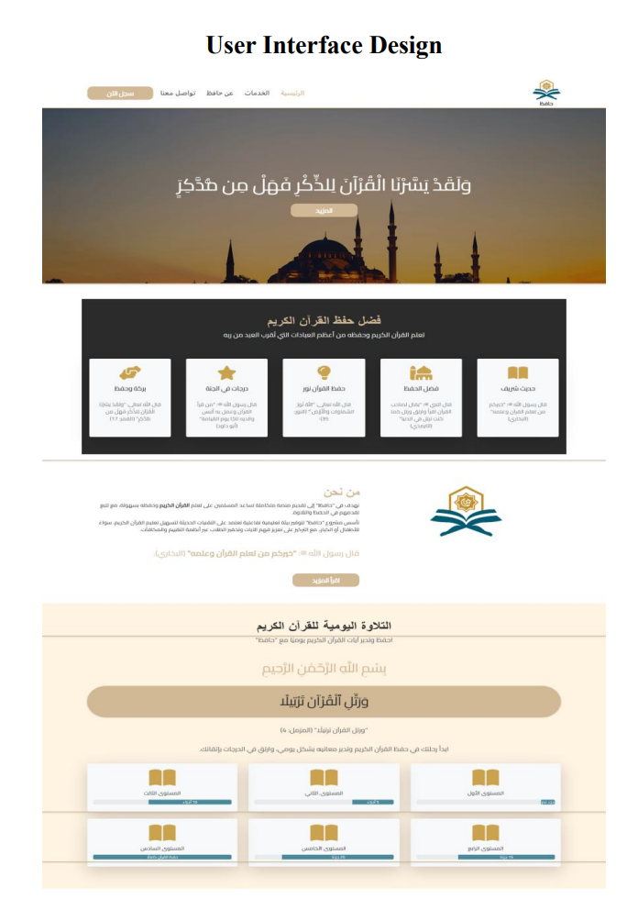
User Interface Design

Slide 14
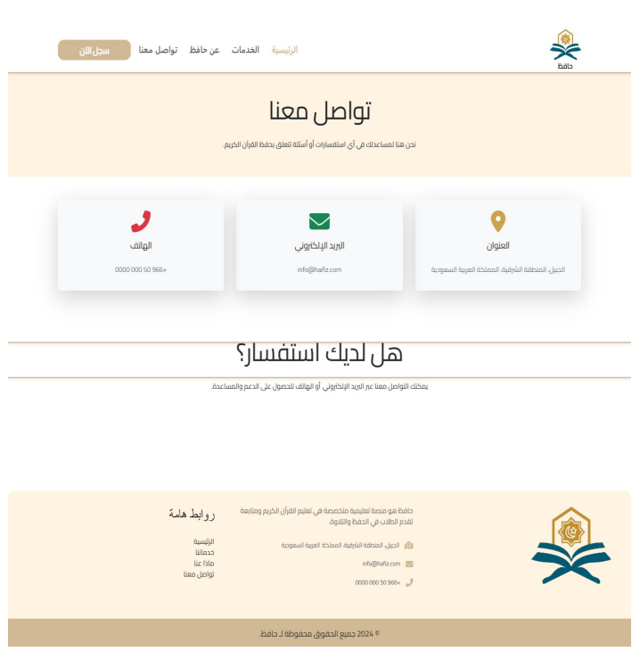
User Interface Design

Slide 15
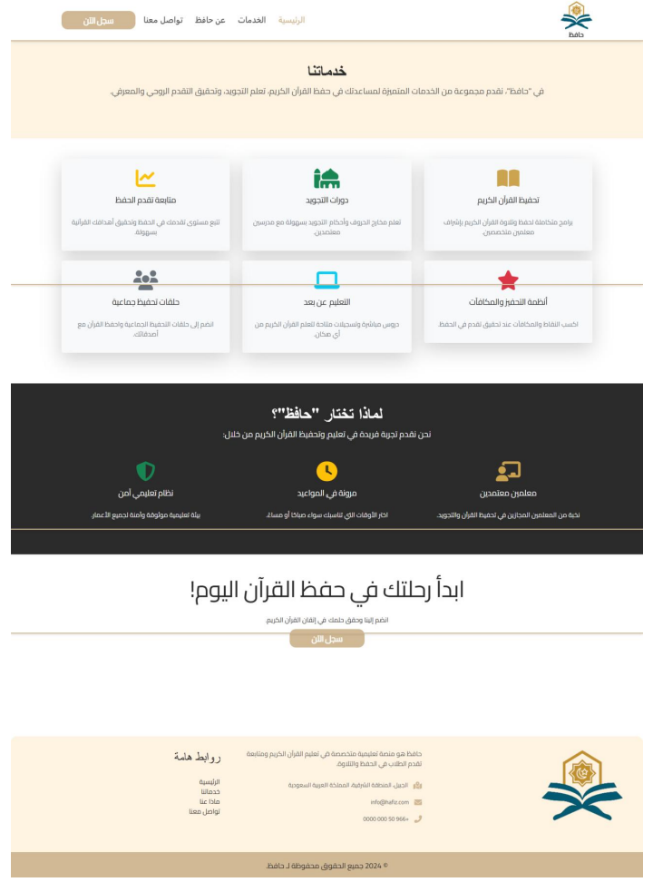
User Interface Design

Slide 16
User Interface Design

Slide 17
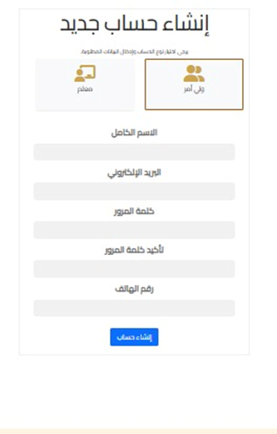
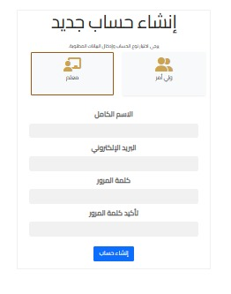
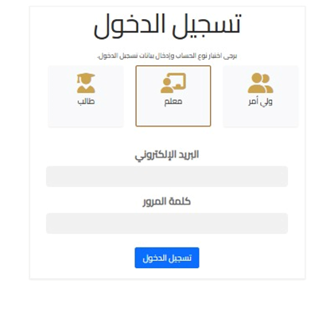
User Interface Design

Slide 18

User Interface Design

Slide 19
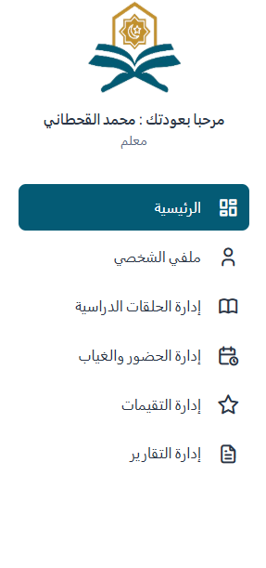
User Interface Design

Slide 20
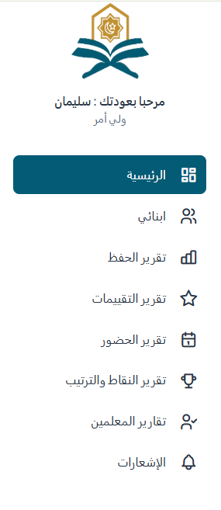
User Interface Design

Slide 21
Thank you

